Slide 1
MEMORY HIERARCHY
Introduction

Slide 2
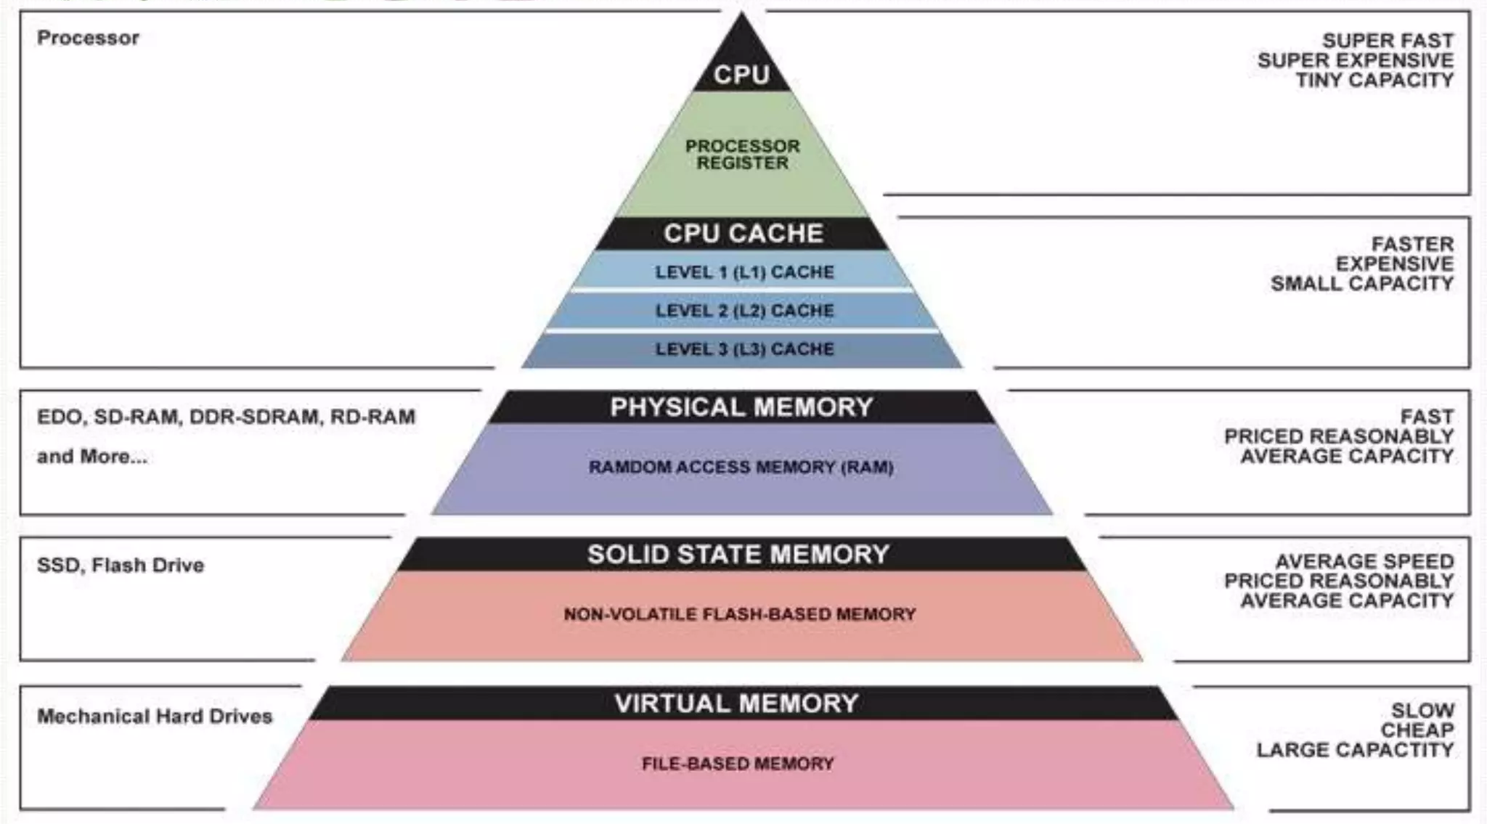

Slide 3
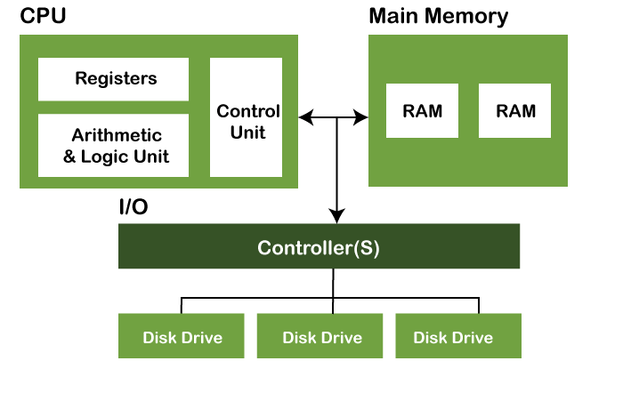
Small
High speed
Fast access
Small storage
(16 to 64 bits)

Slide 4
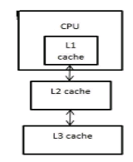
Small
Fast access(Not as fast as registers)
Less capacity
Stores frequently used data

Slide 5
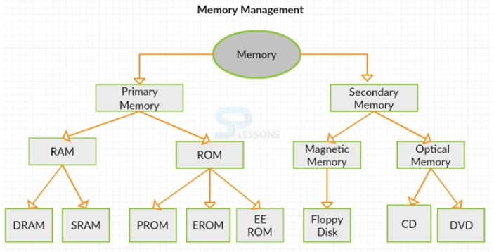

Slide 6
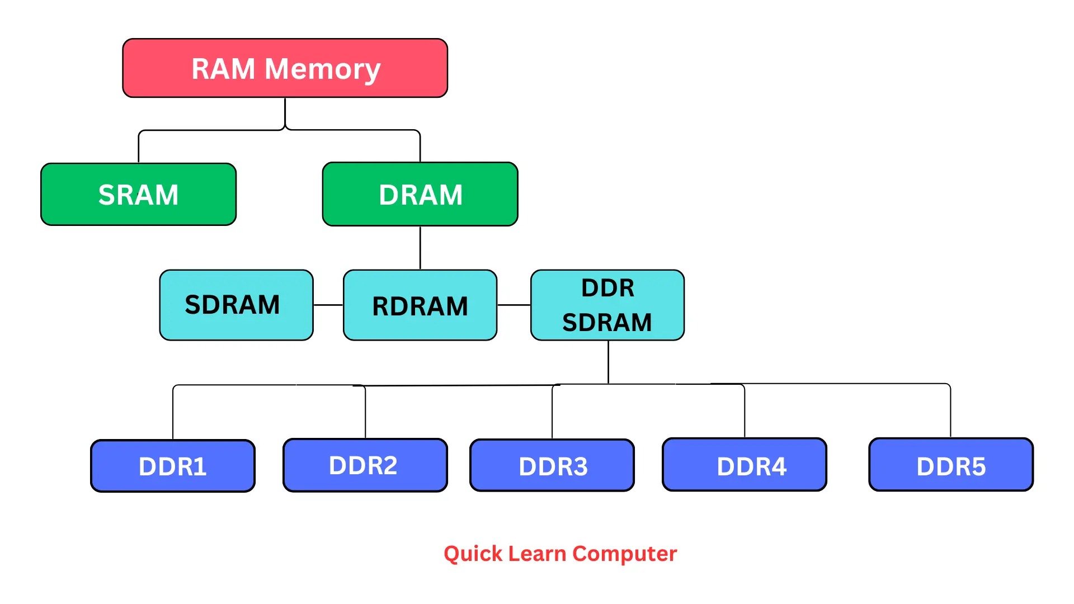

Slide 7
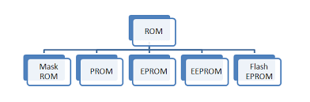

Slide 8
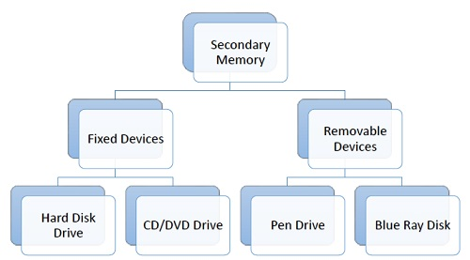

Slide 9
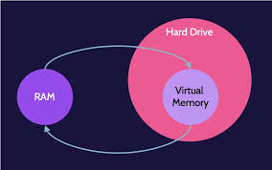

Slide 10
MAIN MEMORY:
RAM - Random Access Memory
Large storage capacity, slower, store data and instruction currently in use
Used for communication with the CPU if it has one or more control inputs that selects the chip when needed.
Can read/write in the memory that does not contain any data.
Volatile - loses data when power is removed.
Types of RAM
Static RAM: Stores binary info in flipflops and information remains until power is supplied. Has fast access and time.
Dynamic RAM: Stores binary info as a charge on capacitor. Requires refreshing circuitry to maintain the charge on the capacitor. Has more memory cells per unit area.

Slide 11
ROM :
It is a non-volatile memory that stores information permanently, even when the power is turned off.
Like RAM, it is also the primary memory of a computer.
It is called read only memory as the programs and data stored in it can be read but cannot be written on it.
EX : Needed in bootstrap loader, which is needed to perform POST(Power On Self Test) on computer to load the OS for the computer into memory.
Types:
Masked ROM
PROM
EPROM
EEPROM

Slide 12
SECONDARY STORAGE:
HDD, SSD. Large storage capacity, slow access, cost effective.
Stores data and instruction that are currently not in use by CPU.
Magnetic disk:
Circular plate fabricated with metal/plastic/magnetized material
Works at high speed and frequently used
Magnetic tape:
Magnetic recording device covered with plastic film. Used for backup of data
Slower time to access, as time requires to access toe strips.

Slide 13
Virtual memory:
Virtual memory uses both the computer's software and hardware to work. It transfers processes between the computer's RAM and hard disk by copying any files from the computer's RAM that aren't currently in use and moving them to the hard disk.
By moving unused files to the hard disk, a computer frees up space in its RAM to perform current tasks, such as opening a new application.
If the computer later needs to use its RAM for a more urgent task, it can again swap files to make the most of the available RAM.

